Slide 1
RSA Payback Information Management System (PIMS): 2025 Data Collection
October 1, 2025

Slide 2
Agenda
Ensuring High-Quality Data
FY 2025 Data Collection Period
Important Reminders
Resources
Questions

Slide 3
Ensuring High-Quality Data

Slide 4

Why Must Data Be High Quality?
The main objectives of PIMS are to:
collect and analyze data on scholars funded by the RLTT grants,
track the service obligation of scholars funded by the RLTT grants, and
use data collected to report on program performance measures.
It is critical that all data are accurate, complete, and timely.

Slide 5
Steps to Ensure High Quality Data
All scholar data reported in PIMS must accurately match information in the Payback Agreement and Exit Certification forms, including:
Grant number
Scholar name
Funding amount
Graduation/exit date
Service obligation length
Upload financial documentation to verify funding amounts in Section F

Slide 6
FY 2025 Data Collection: Updating Scholar Records

Slide 7
FY 2025 Data Collection
By October 31, 2025 (Cohort 1) or November 14, 2025 (Cohort 2) grantees must:
Update scholar records
Create new records for scholars not already in PIMS
Contact scholars with a request to log in to PIMS
Review pending employment records
Not submitting data on time is against regulations and can jeopardize current or future funding
Do not wait until the data collection period to enter and update data

Slide 8
Updating Scholar Records – Enrolled Scholars
For scholars who are still enrolled, grantees will need to update the following sections on each Scholar Record:
Section D: Complete a new Payback Agreement (if applicable)
Section F: Current Training Program Information
Question #4: Full or part-time enrollment
Question #5: Funding amount
Question #6: Employment while enrolled in the program
Section G: Scholar Status
Question #1: Scholar status
Question #2: Accumulated academic years of funding

Slide 9
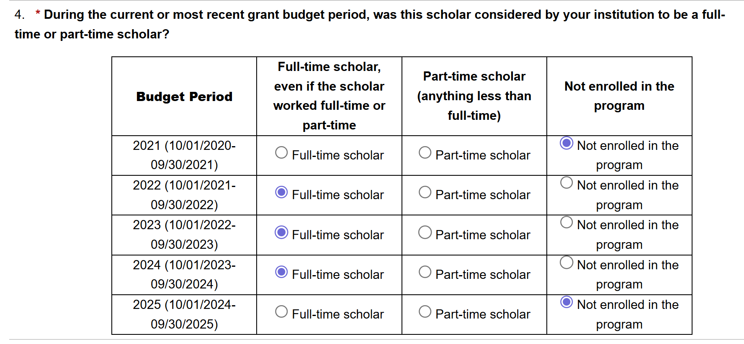
Updating Scholar Records (Part 2)

Slide 10
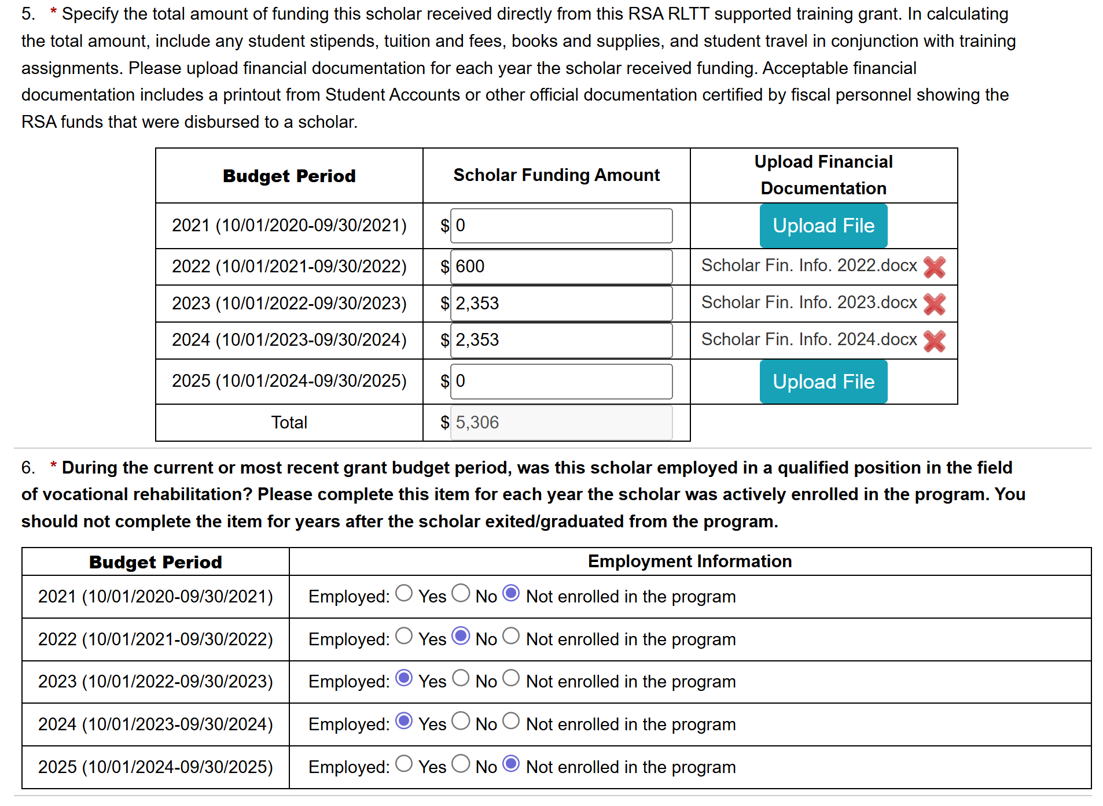
Updating Scholar Records (Part 3)

Slide 11
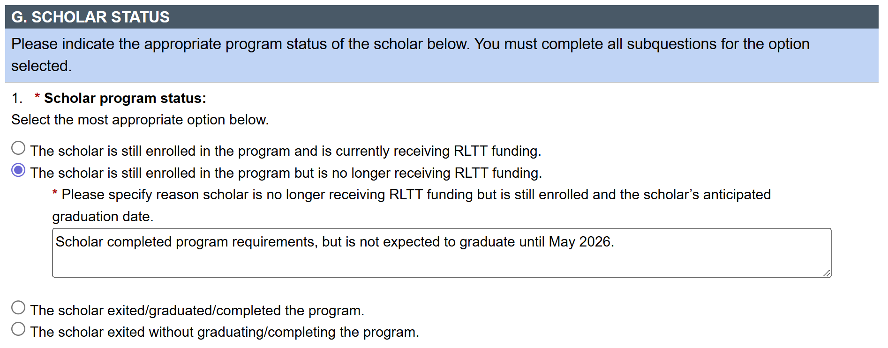
Updating Scholar Records - ENRF
For scholars who are still Enrolled but No longer Receiving Funding (ENRF), confirm they are still enrolled in the university but not receiving funding support through the grant.
In the text box, enter/update an explanation of why the scholar is enrolled but no longer receiving funding and enter the scholar’s anticipated graduation date.
Scholar Records MUST be updated to graduated/exited prior to completion in PIMS when the scholar graduates/exits.

Slide 12
Updating Scholar Records – Graduated & Exited Scholars
For scholars who graduated/completed or exited before completing the program, grantees will need to update the following sections on each Scholar Record:
Section F: Current Training Program Information
Questions #4, 5, and 6
Section G: Scholar Status
Question #1: Scholar status
Question #2: Accumulated academic years of funding
Section H: Scholar Exit Information
Not needed for scholars who exit prior to graduation
Section I: Upload Signed Exit Certification or complete Digital Exit Certification

Slide 13
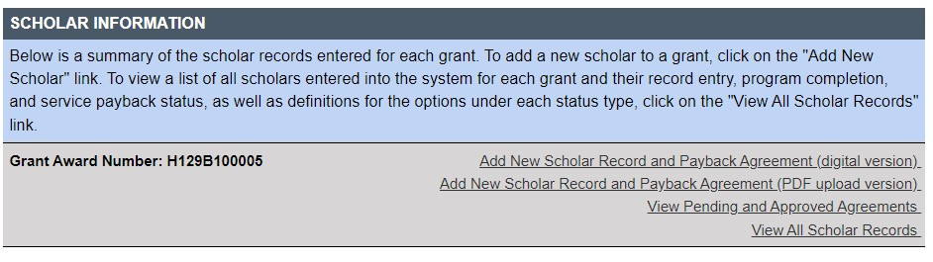
Create New Scholar Records
For scholars who received RSA funding during FY 2025 and are not currently listed in PIMS, create a new Scholar Record.
Be sure to type in the scholar’s SSN to ensure there isn’t an existing record for the scholar in PIMS.

Slide 14
FY 2025 Data Collection: Scholar Tasks in PIMS

Slide 15



How Scholars Use PIMS
Scholars review their contact and training information in the system
Scholars submit employment data electronically
Grantees & employers approve & verify employment information electronically

Slide 16
Expectations for Scholars in PIMS
Enrolled scholars must:
Update contact information (Sections A-C)
Complete the digital Payback Agreement
Verify academic and service obligation data are correct (Sections D-E)
Graduated/Exited scholars should also:
Complete the digital Exit Certification
Report employment data (Section F)
Request a deferral or waiver, if applicable (Section G)

Slide 17
Contact Scholars to Login to PIMS
Remind scholars via email to log in to PIMS (scholars in “Awaiting Login” status);
Share a copy of the broadcast email with your RSA program officer for record purposes.
Why is this step important?
Ensures PIMS has correct email address(es) for scholars
Verifies scholars are receiving communication from PIMS (reminders, employment verification notifications, etc.)
Provides an opportunity for scholars to get acquainted with PIMS
Gives scholars access for reporting on their requirement of fulfilling their service obligation

Slide 18
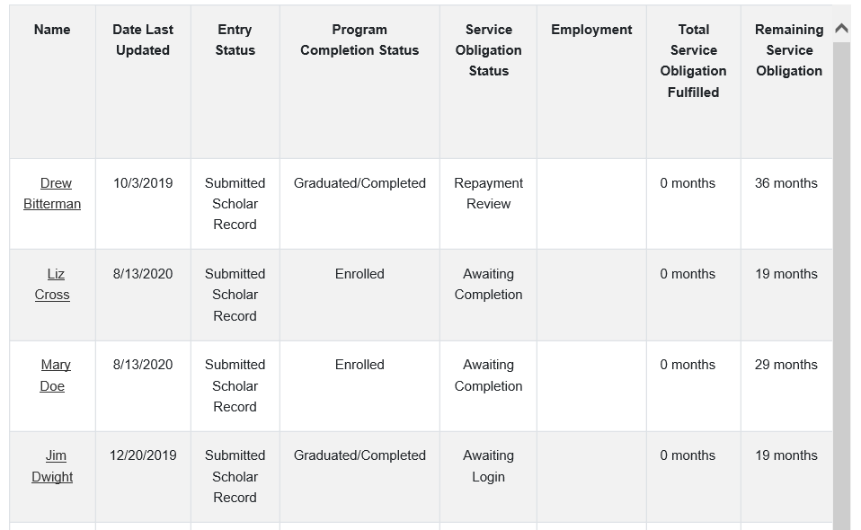
View All Scholar Records

Slide 19
Strategies for Reaching Scholars
Notify scholars as soon as they are enrolled about their requirements to login to PIMS.
Remind scholars while enrolled and at their exit/graduation.
Always enter a non-university email address for use in PIMS.
Scholars will need to access PIMS after graduation and often are unable to use a university email address
If you have lost contact with scholars:
Reach out to scholars on social media.
Check with the university, other scholars, emergency point of contact, or university personnel who know the scholar for updated contact information.
Try other modes of contact like mailing or texting.

Slide 20
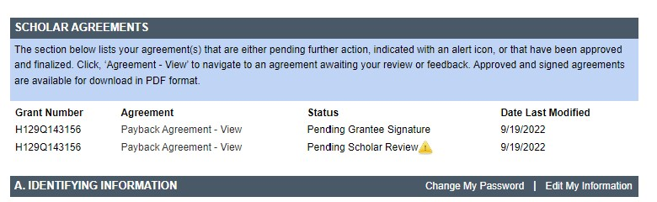
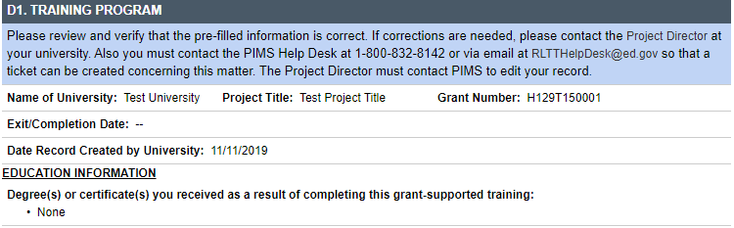
Scholars’ View in PIMS
Identifying information and contact information fields are the same as the grantee view

Slide 21
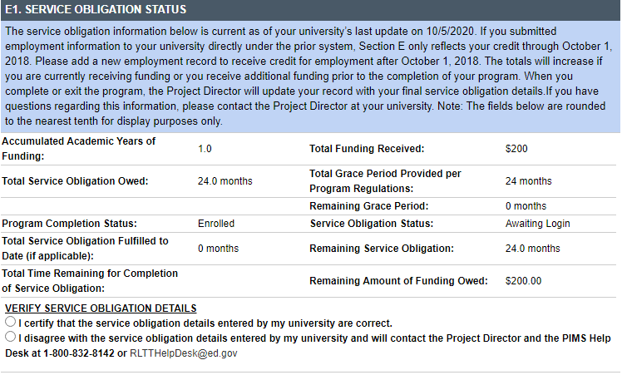
Scholars’ View in PIMS (cont’d)

Slide 22
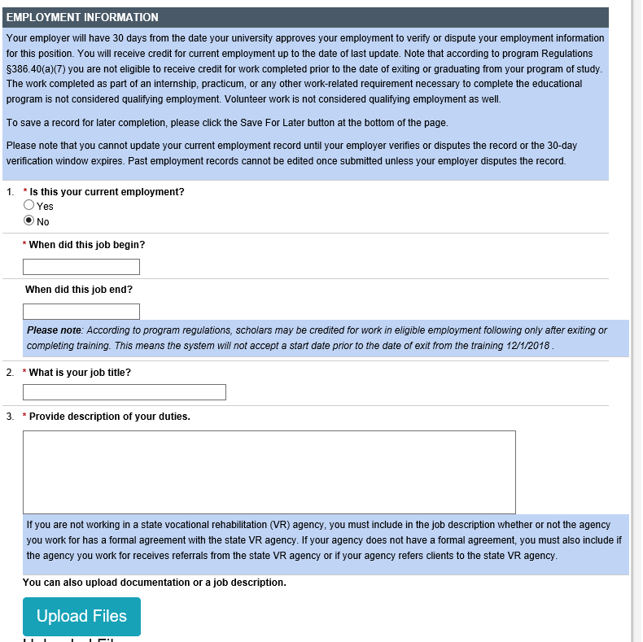
Employment Information

Slide 23
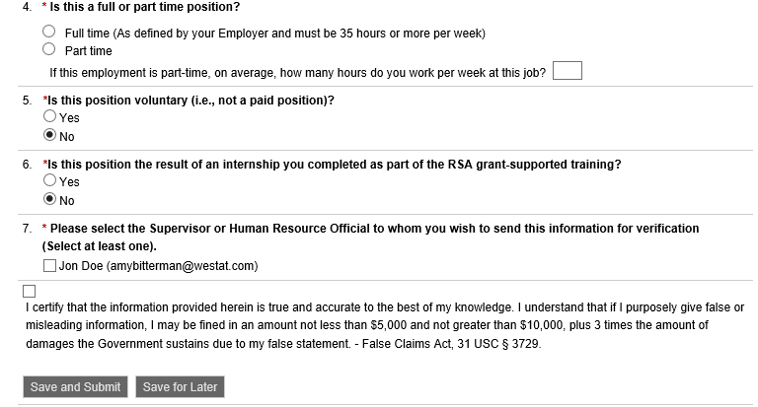
Employment Information (cont’d)

Slide 24

Grantee Review of Scholar Employment
Grantees review scholars’ employment information to determine if the scholar's position (title) and job duties qualify for payback consistent with the program regulations.
The duties must entail that the scholar provides direct service to clients in one of the 30 rehabilitation fields of study to be acceptable for payback.
Decision will trigger an email notification to scholar
Approval will also trigger employment record to be sent to employer for verification

Slide 25
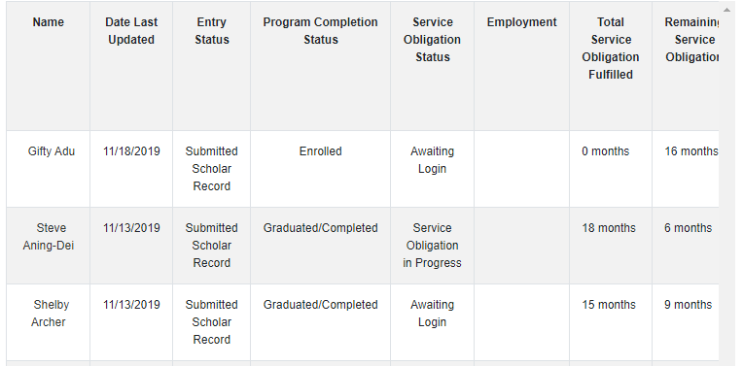
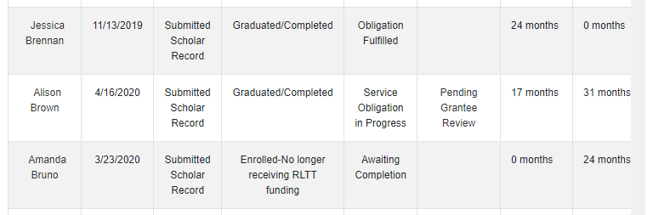
Review Pending Employment Records

Slide 26
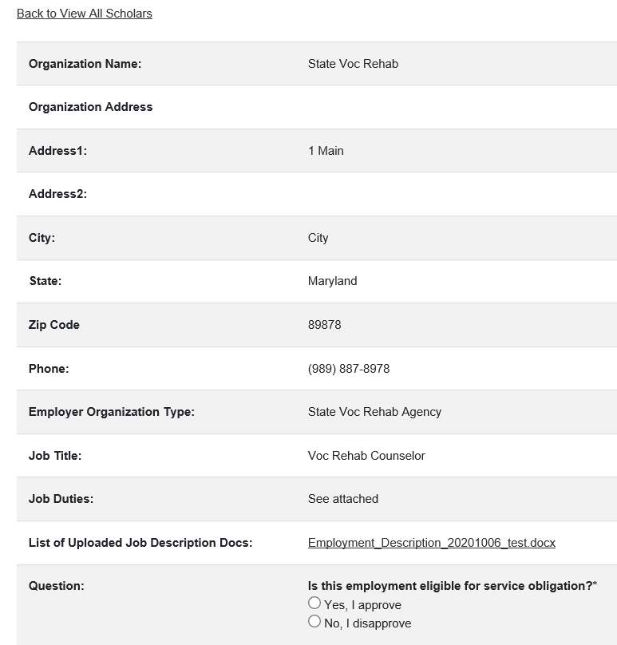
Review Pending Employment Records (cont’d)

Slide 27
Important Reminders

Slide 28
Security Incidents
A security incident, or data breach, is a violation or an imminent threat of a violation of security policies, acceptable use policies, or standard security practices.
Security incidents involve the disclosure or potential disclosure of personally identifiable information (PII), which is information that can be used to distinguish or trace an individual’s identity.

Slide 29
Protecting Sensitive Data
Tips to help protect PII:
Redact Social Security numbers (SSNs) from all documents.
Do not include SSNs in email correspondence to the Help Desk.
If you need to email documents containing PII, always encrypt the document and send the password in a separate email.
Always check to make sure the documents being uploaded match the Scholar Record.

Slide 30
Using Digital Agreements
How does it work?
PD enters scholar contact and grant info directly into PIMS
Digital Payback Agreement (PA) form captures this information to create Scholar Record during enrollment
Scholars and PD sign PA online through PIMS
When scholar exits, the PD completes and signs an Exit Certification
Scholars review and sign EC online through PIMS

Slide 31
Using Digital Agreements (cont’d)
Benefits:
Allows PDs to work directly with scholars through PIMS
Avoids errors since the PA automatically pre-fills sections A,B, and C in the PIMS Scholar Record
Saves time printing/scanning/uploading agreements
Reduces security risks since PII will be automatically redacted in agreements
PDs can download the agreements from PIMS in PDF form at any time

Slide 32
Using Digital Agreements Resources
More info:
PIMS Digital Agreements Training Slides: https://pdp.ed.gov/RSA/Content/pdf/PIMS%20Digital%20Agreements%20Training%20-%20May%202022.pdf
PIMS Digital Agreements Training Recording: https://youtu.be/5acvxXHNZ3M
PIMS Digital Agreements FAQ:
https://pdp.ed.gov/RSA/Content/pdf/Digital%20PA%2 and%20EC%20Info%20Sheet%2020240926.pdf
Contact PIMS Help Desk for assistance

Slide 33
Do Not Wait for the Data Collection Period!
PIMS is available year round
Enter, update and upload data and agreements within 30 days of a scholar’s change in status
Newly funded scholars
When scholars graduate or exit
Do not leave Scholar Records in a pending status for more than 30 days

Slide 34
Resources & Contact Info

Slide 35
Helpful Resources
Frequently Asked Questions
https://pdp.ed.gov/RSA/Home/faq/
Grantee Quick Reference Guide https://pdp.ed.gov/RSA/Content/pdf/PIMS%20Grantee%20Quick%20Reference%20Guide.pdf
Grantee Instructions for Reviewing Scholars’ Employment
https://pdp.ed.gov/RSA/Content/pdf/Grantee%20Steps%20for%20Reviewing%20Scholar%20Employment.pdf
Using the New Digital Process for Completing Payback Agreements (PA) and Exit Certifications (EC) in the Payback Information Management System (PIMS)
https://pdp.ed.gov/RSA/Content/pdf/Digital%20PA%20and%20EC%20Info%20Sheet%2020240926.pdf

Slide 36

Contact Us
Email RLTTHelpDesk@ed.gov or call
1-800-832-8142 with questions or comments
The Help Desk is available Monday through Friday from 8am to 8pm (Eastern Time)

Slide 37

Questions

